Slide 1
Capstone Project Hotel Booking analysis
Submitted By
Vibha Kumari

Slide 2
Problem Statement
We are provided with a hotel bookings dataset.
Our main objective is to perform EDA on the given dataset and draw useful conclusions about general trends in hotel bookings
and how factors governing hotel bookings interact with each other.

Slide 3
Dataset: we are given a hotel bookings dataset. This dataset contains booking information for a city hotel and a resort hotel. It contains the following features.

Slide 4
DATA SUMMARY
Hotel : Name of hotel ( City or Resort)
Is _canceled: Whether the booking is canceled or not (0 for no canceled and 1 for canceled)
Lead _time: time (in days) between booking transaction and actual arrival.
Arrival_ date _ year : Year of arrival
arrival_date_month : month of arrival
Arrival _ date_ week _ number : week number of arrival date.
Arrival _ date_ day_ of _ month : Day of month of arrival date.
Stays _ in_ weekend_ nights : No. of weekend nights spent in a hotel
Stays _in _ week_ nights : No. of weeknights spent in a hotel

Slide 5
DATA SUMMARY
Meal : Type of meal chosen
Country : Country of origin of customers (as mentioned by them)
Market _ segment : What segment via booking was made and for what purpose.
Distribution _ channel: Via which medium booking was made
Is _repeated _ guest: Whether the customer has made any booking before(0 for No and 1 for Yes)
Days _ in_ waiting_ list: No. of days on waiting list.
Customer _ type: Type of customer(Transient, Group, etc.)

Slide 6
CLEANING DATA
#checking missing values in the columns
df.isnull().sum()
#filling the null value with’0'
df["agent"].fillna ('0',inplace=True)
df["country"].fillna('0',inplace=True)
df["children"].fillna('0',inplace=True)
#drop the company column as it has very high null value
#df["company"].dropna('o',inplace=True)
df = df. Drop('company', axis=1)
#checking duplicated values
df.duplicated().any()

Slide 7
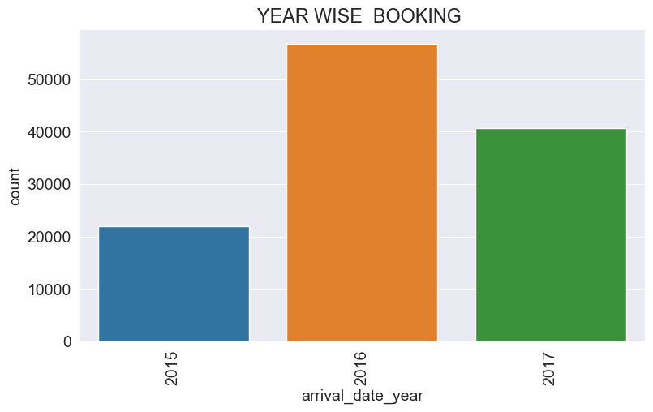
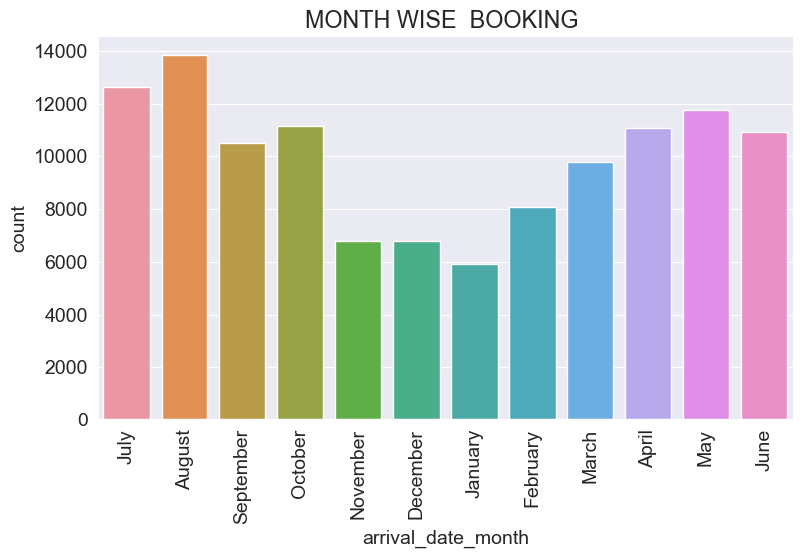
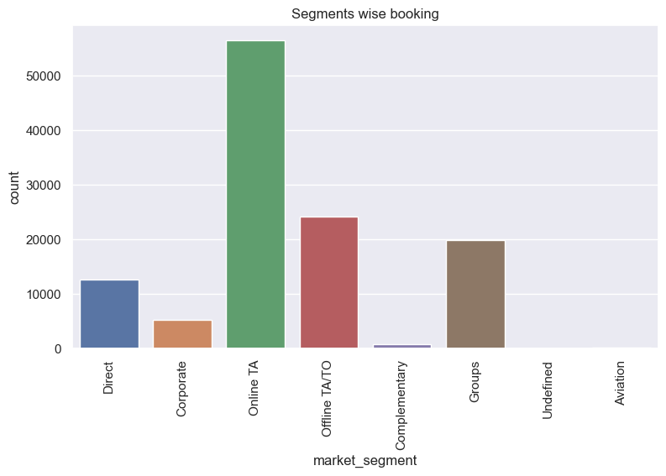
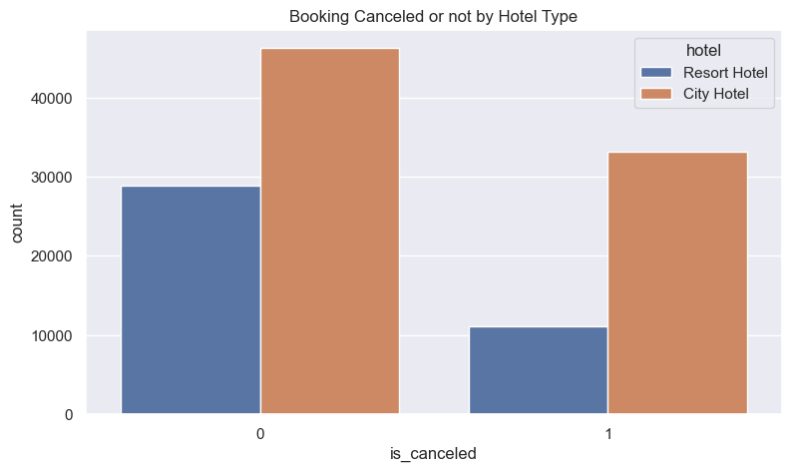
EXPLORATORY DATA ANALYSIS

Slide 8
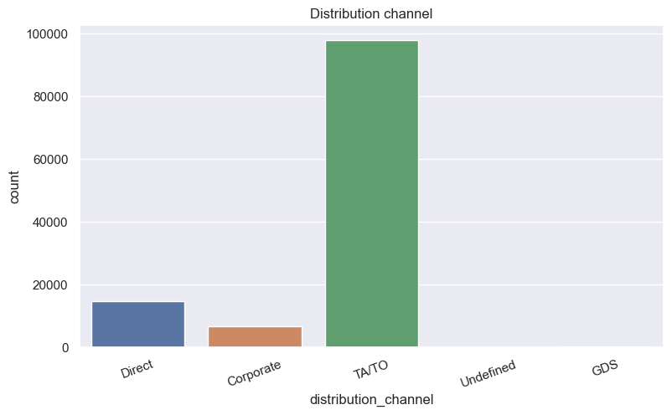
highest booking has been done through online TA.
highest Distribution channel has been online TA/TO.

Slide 9
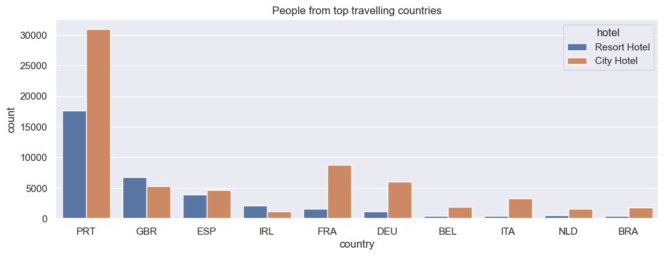
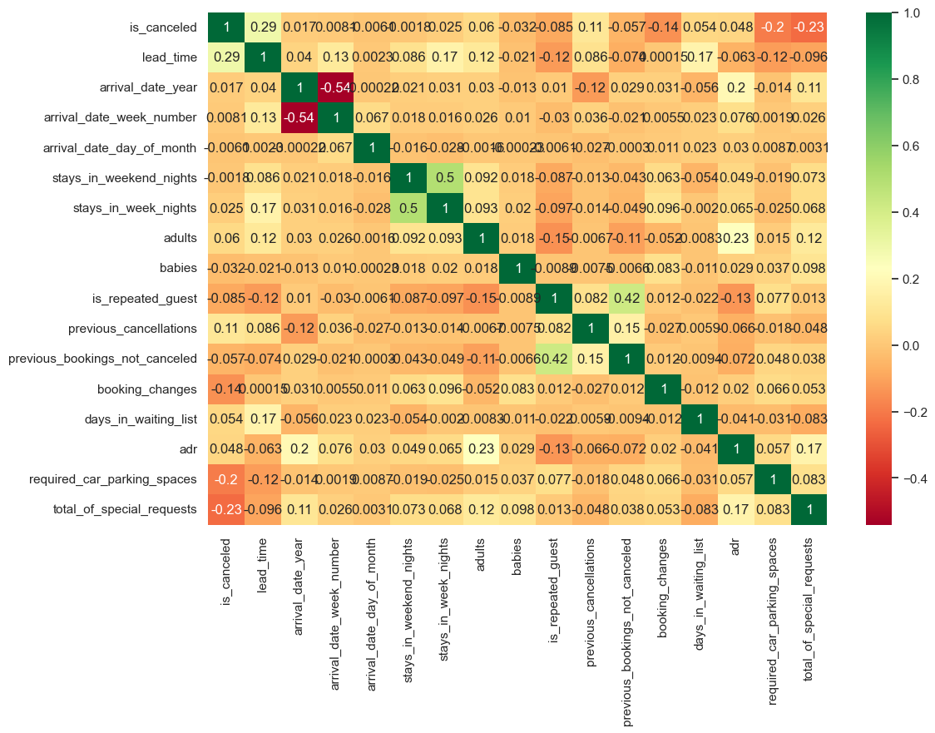
prt is the top travelling country
#Lets see the correlation

Slide 10
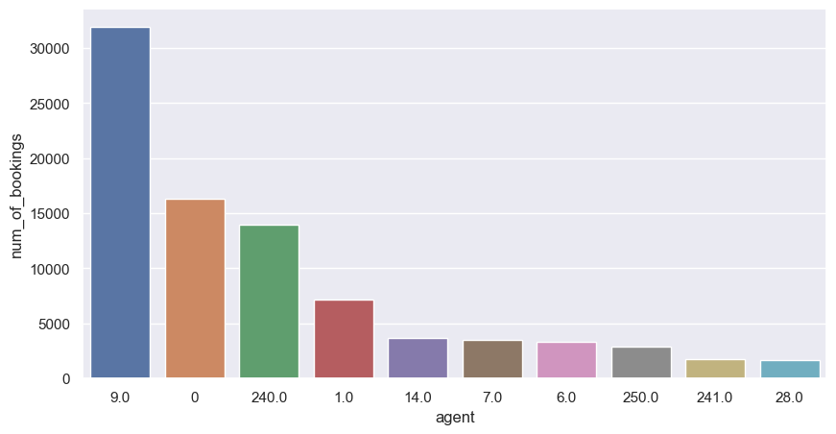
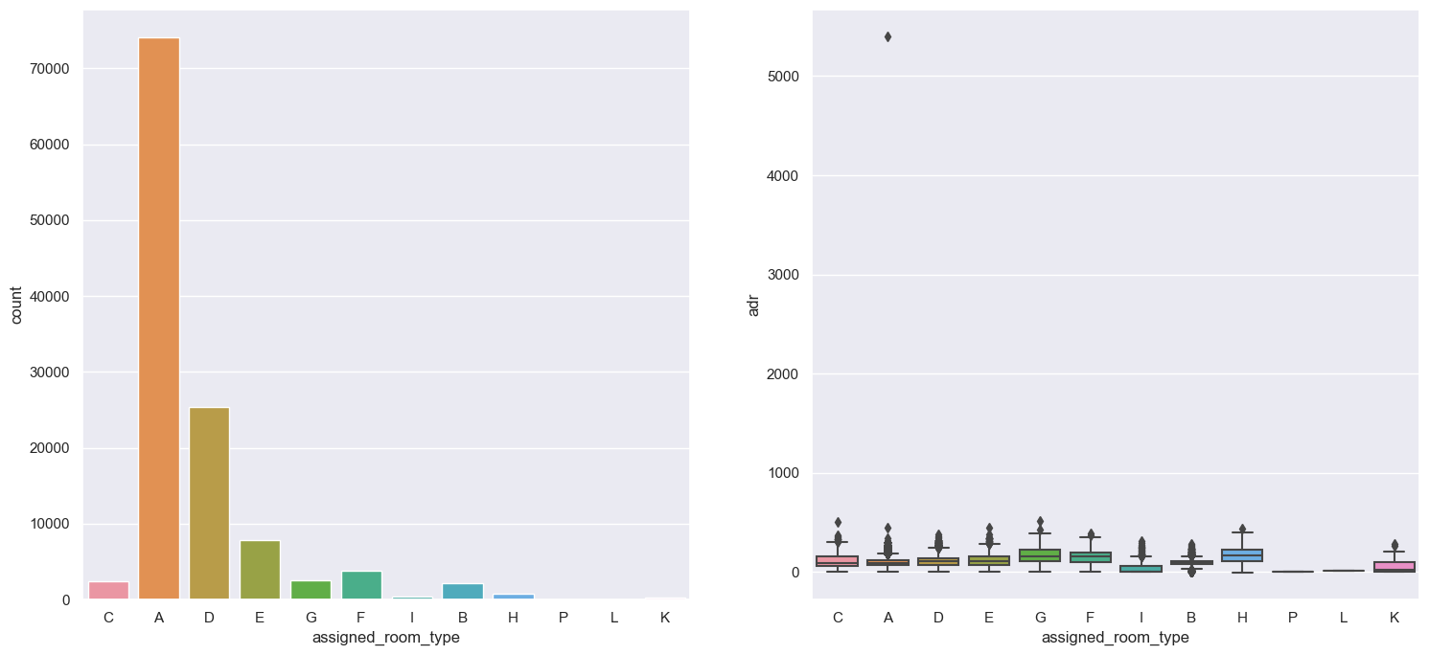
Agent no. 9 has made most no. of bookings.
Most demanded room type is A, but better adr rooms are of type H.

Slide 11
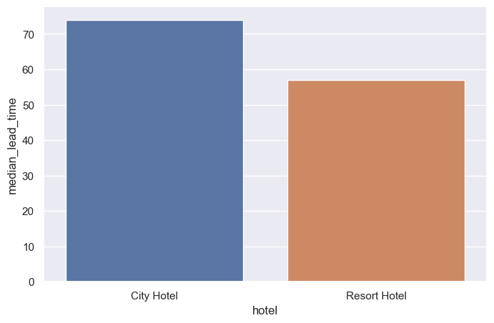
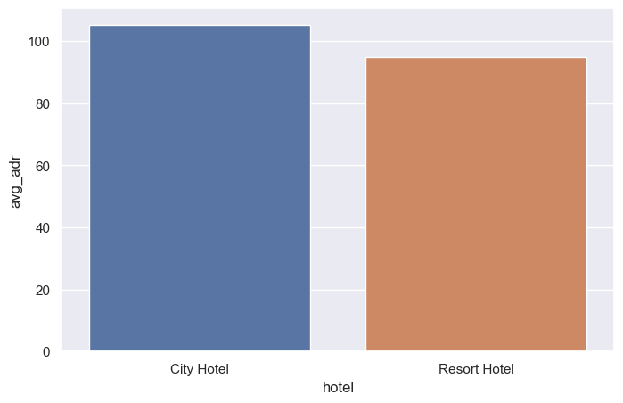
Which hotel has higher lead time?
which hotel seems to make more revenue?

Slide 12
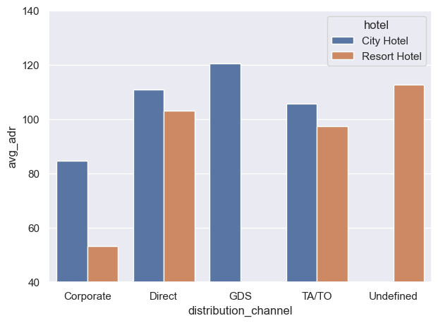
Which distribution channel brings better revenue generating deals for hotels?

Slide 13
CONCLUSION
(1) Around 60% bookings are for City hotel and 40% bookings are for Resort hotel, therefore City Hotel is busier than Resort hotel. Also the overall adr of City hotel is slightly higher than Resort hotel.
(2) Most of the guests came from European countries, with most of guests coming from Portugal.
(3) Guests use different channels for making bookings out of which most preferred way is TA/TO.
(4) For hotels higher adr deals come via GDS channel, so hotels should increase their popularity on this channel.
(5) Almost 30% of bookings via TA/TO are cancelled.
(6) Not getting same room as reserved, longer lead time and waiting time do not affect cancellation of bookings.
Although different room allotment do lowers the adr.
(8) Within a month, adr gradually increases as month ends, with small sudden rise on weekends.

Slide 14
(9) August is the most occupied (busiest) month with 11.62% bookings and
(10) January is the most unoccupied month with 5.0% bookings.
(11) 2016 is the most booked year with 47.50% bookings .
(12) highest distribution is made by TA/TO.
(13) TA/TO has highest booking cancellation %
(14) Both hotels have very small percentage that customer will repeat, but Resort hotel has slightly higher repeat % than City Hotel.
(15) City hotel has slightly higher median lead time. Also median lead time is significantly higher in each case,
this means customers generally plan their hotel visits way to early.

Slide 15
THANK YOU!

